Slide 1
Clock Tree Synthesis
Workshop Session 6
Presented by
Hafiz Wajeh ul Hasan

Slide 2
Design.v, Design.sdc, Std_cells.lef, Std_cells.lib
Input
Synthesis
Yosys, OpenSTA
Design_gate_level_netlist.v
Output
Design_gate_level_netlist.v, macro.lef, macro.cfg
Input
Floorplanning/Power Network
init_fp, ioplacer, pdn
Floorplan.def
Output
Floorplan.def
Input
Placement
RePLace,OpenDP
Placement.def
Output
Open-source EDA Tools
Design_gate_level_netlist.v, Placement.def
Input
CTS
TritonCTS
CTS.def, CTS_netlist.v
Output
Input
Routing
FastRoute, TritonRoute
CTS.def
Routing.def
Output
Input
RC Extraction
SPEF-Extractor
Routing.def
Design.spef
Output
Input
GDS Generation
Magic
Input
Routing.def
Output
Output
Design.gds, Design.lef
Input
Physical Verification
APR Step
Design.gds
Magic
EDA Tool

Slide 3
Contents
Clock Tree Synthesis
Why Clock Tree Synthesis?
Timing
Power
Signal integrity
Solution
Tree
H-Tree
Grid [ Mesh Tree ]
Spine Tree
LAB PRACTICE

Slide 4
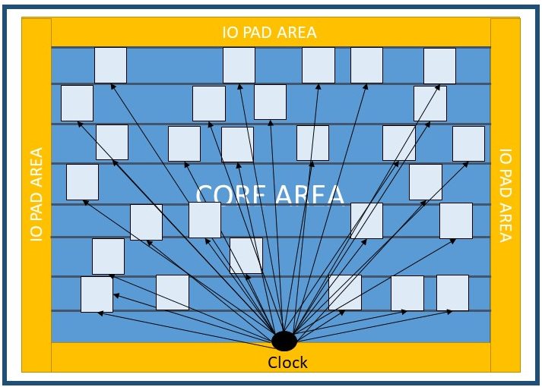
Clock Tree Synthesis
Clock Tree Synthesis (CTS) is a process which distributes the clock evenly to all sequential elements in a design
It adds buffers and inverters to achieve zero/minimum skew or balanced skew

Slide 5
Clock Tree Synthesis
Why can’t the clock be routed like any other net?
Implications on clock
Timing
Power
Signal integrity etc.
IO PAD AREA
FF
FF
CORE AREA
FF
FF
FF
FF
FF
FF
FF
FF
FF
FF
FF
FF
FF
FF
FF
IO PAD AREA
IO PAD AREA
FF
FF
FF
FF
FF
FF
FF
FF
FF
Clock

Slide 6
Timing
Skew
Clock skew is the difference in the arrival time of a clock signal at two different Flops.
Jitter
Clock jitter is the deviation of a clock edge from its ideal position in time
Slew
Transition time of the clock- rise/fall time of the clock
Insertion Delay
The amount of time taken by the clock signal to travel from source to sinks is called the insertion delay

Slide 7
Skew
ff1
Combinational logic
ff2
q1
q2
Launch Clock
Capture Clock
clk
2ns
Launch clock
Skew
= 3-2 =>1 ns
Positive skew
Capture clock
3ns

Slide 8
Skew
ff1
Combinational logic
ff2
q1
q2
Launch Clock
Capture Clock
clk
2ns
Launch clock
Skew
= 2-3 => -1 ns
Negative skew
Capture clock
3ns

Slide 9
Jitter
50ns
Ideal clock
100ns
150ns
CAUSES
PLL Noise
Power Supply Ripples
Temperature Variations
Crosstalk Between Signals
50ns
Realistic clock
Jitter

Slide 10
Slew
90 %
10 %
Time taken from 10% till 90% during the transition
10 %
90 %

Slide 11
Insertion Delay
IO PAD AREA
FF
FF
CORE AREA
FF
FF
FF
FF
FF
FF
FF
The time from the source of the clock to the sink is called insertion delay
FF
FF
FF
FF
FF
FF
FF
FF
IO PAD AREA
IO PAD AREA
FF
FF
FF
FF
FF
FF
FF
FF
FF
Clock
Source

Slide 12
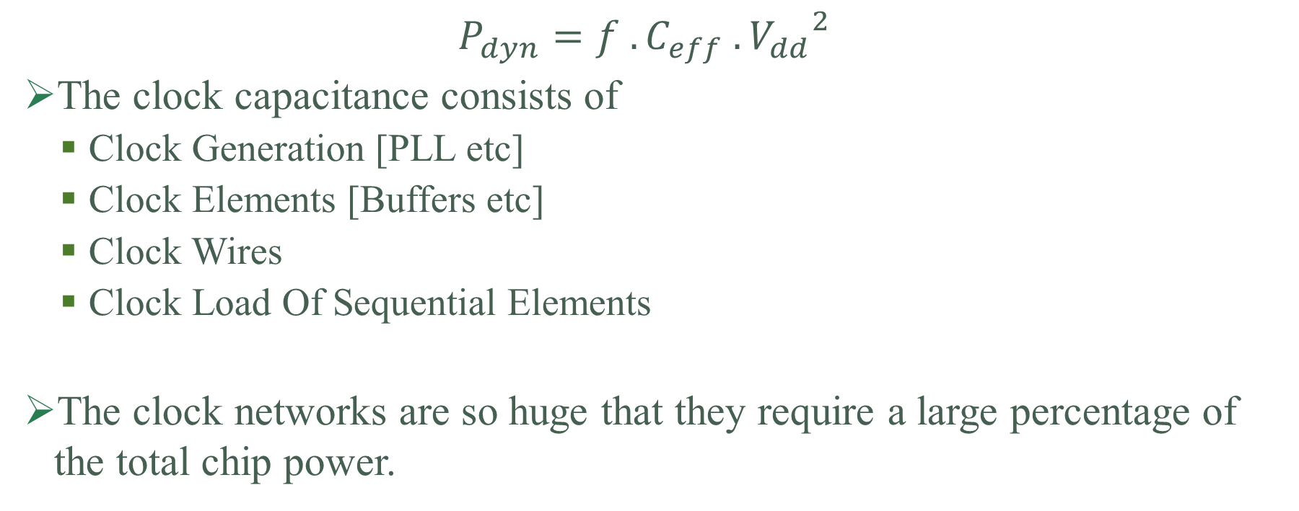
Power
$$P_{dyn}=f . C_{eff} .{V_{dd}}^{2}$$
The clock capacitance consists of
Clock Generation [PLL etc]
Clock Elements [Buffers etc]
Clock Wires
Clock Load Of Sequential Elements
The clock networks are so huge that they require a large percentage of the total chip power.

Slide 13
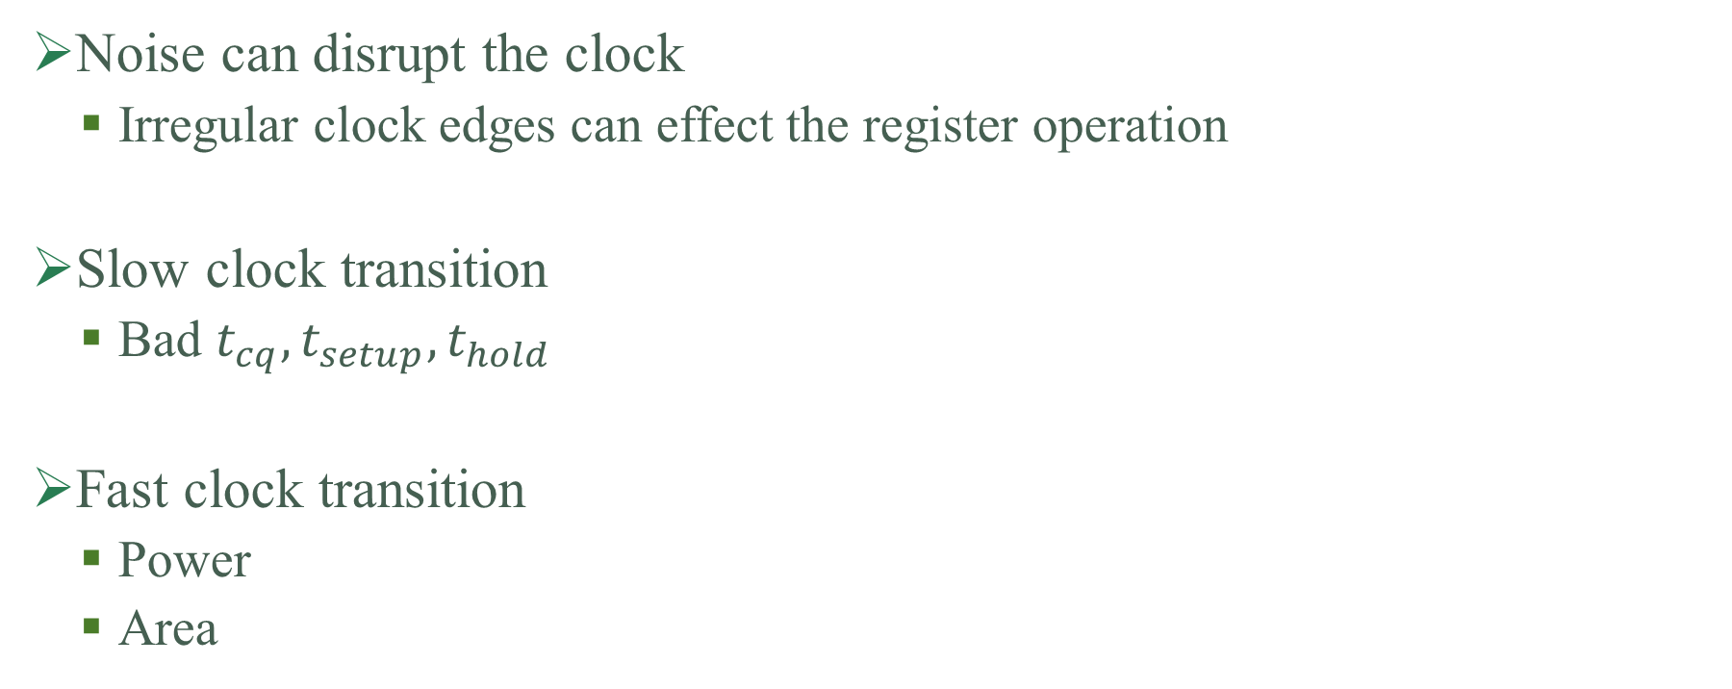
Signal Integrity
Noise can disrupt the clock
Irregular clock edges can effect the register operation
Slow clock transition
Bad $t_{cq}, t_{setup}, t_{hold}$
Fast clock transition
Power
Area

Slide 14
Solution?
Trees
H-Tree
Mesh Tree [ Grid]
Spine tree

Slide 15
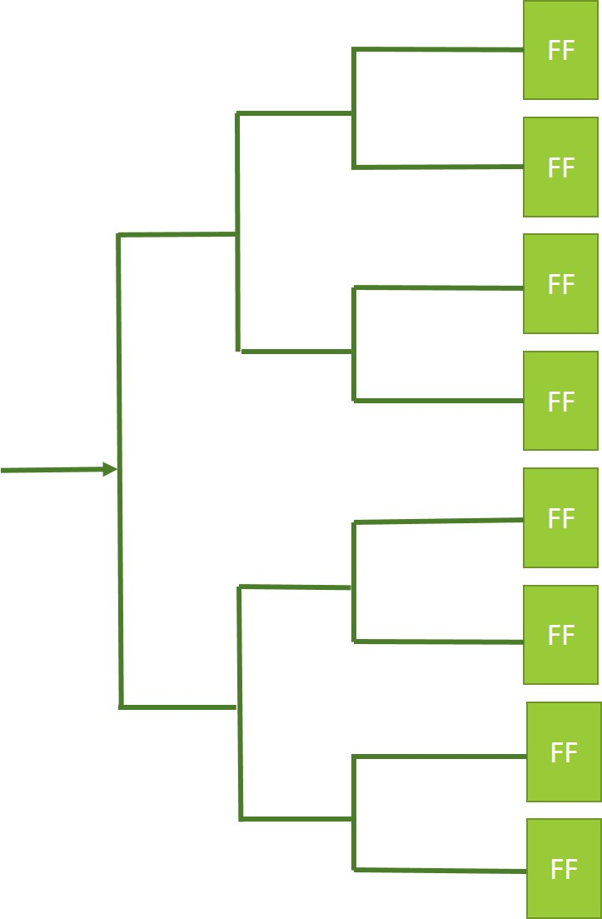
Clock Tree
Try to make a tree
Balance the RC-Delay
Challenges ?
Excessive power usage
Large RC for each net
Signal integrity at risk
Solution ?
Buffered Tree

Slide 16
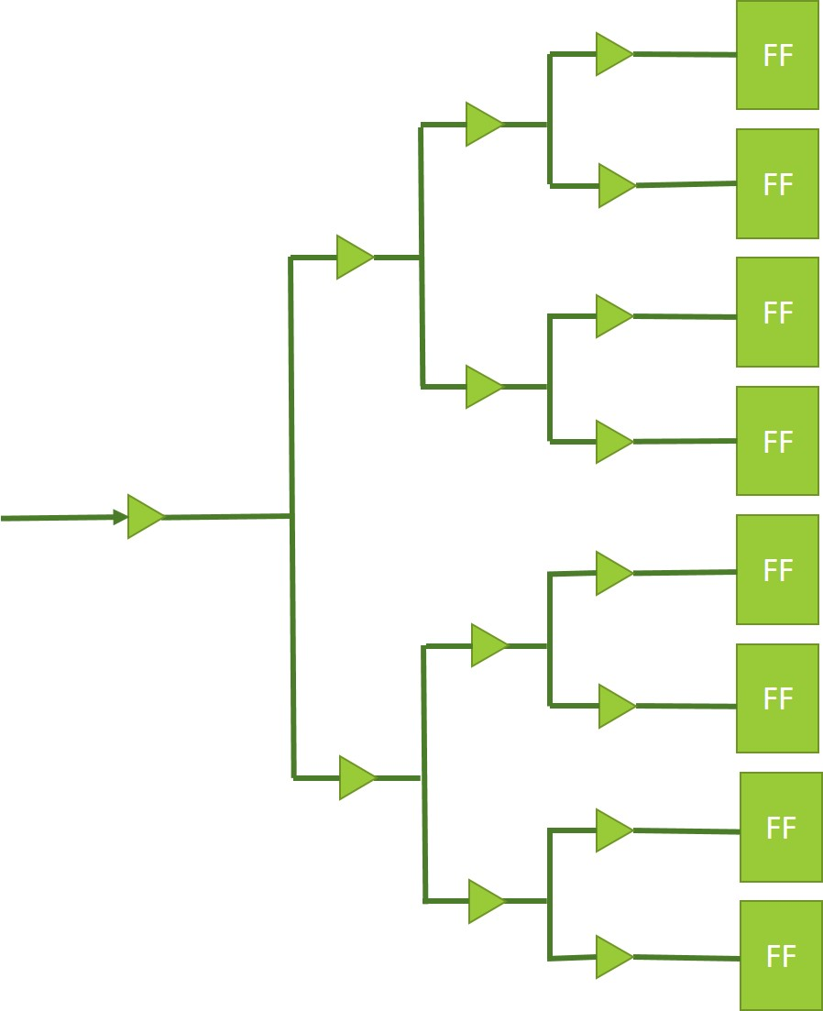
Buffered Tree
Good slew rates
Less total switching capacitance
Lower RC Values

Slide 17
H-Tree
Advantages
The skew in this type of tree is lower
Power consumption is tolerable
Disadvantages
Very low floorplan flexibility
H-Tree

Slide 18
Grid
Advantages
Skew is determined by the grid density and not overly sensitive to load position
Signals are available across the chip
Extreme low skew values
Disadvantages
Power hungry
Large wire cap
Large routing area
FF
FF
FF
FF
FF
FF
FF
FF
FF

Slide 19
Spine Tree
Advantages
Small RC delay
Floorplan flexibility higher than H-Tree, But lower than Mesh Tree
Consumes less power as compared to Mesh Tree/Grid
Disadvantages
Difficult to balance delays, high skew
FF
FF
FF
FF
FF
FF
FF
FF

Slide 20
A Quick Comparison
Structure | Skew | Cap/area/power | Floorplan Flexibility
H-Tree | Low /medium | Low | Low
Grid | Low | High | High
Spine | High | Medium | Medium

Slide 21
LAB PRACTICE

